Slide 1


Mathematical model of the NFkB signalling pathway
Student: Carlos Andres Mariscal Melgar
Supervisor: Dr Steven Webb
MRes Biomedical Sciences and Translational Medicine: Drug safety strand

Slide 2
Nuclear-Factor kappaB Pathway
NFkB Signalling
IKKa dependant activation
nNFkB nuclear transport dependant
Self-regulated negative feedback (eg. P53 mediated repression of NFkB activity)
NFkB
Involved in cellular response to stress (eg. Bacterial and viral antigens)
Failure in regulation linked to disease (eg. Autoimmune, Cancer)

Slide 3
Nuclear-Factor kappaB Pathway
Why model the NFkB pathway
Modular elements of the model can be used on a larger scale model of a whole cell system
Understanding of the system allows us to affect it in order to elicit a desired physiological response

Slide 4
Systems Biology
- Interdisciplinary approach to biological issues
- Aims to understand biological systems through the use of methods initially oriented for the physical sciences
- Improves predictive value for experimental biology
- Prediction of system perturbation effects

Slide 5
Objectives
-To build an in silico model of NFkB signalling (rotation 1)
-Can be expanded to incorporate BTK signalling modules (rotation 2)
- Can be analysed to optimize for use with BTK inhibitors (eg. Ibrutinib)
-Predictive value for KO signalling and Wild type signalling

Slide 6
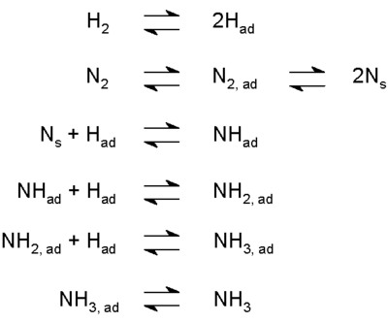
Kinetic Laws
Mass Action
B
B
k_{ass} (M⁻¹s⁻¹ )
association
A + B
AB
AB
dissociation
k_{diss} (s⁻¹ )
A
A
B
association
equilibrium
dissociation

Slide 7
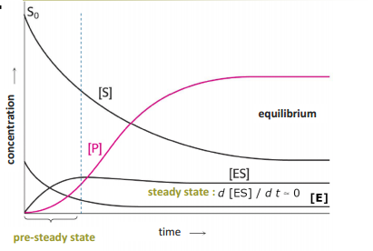
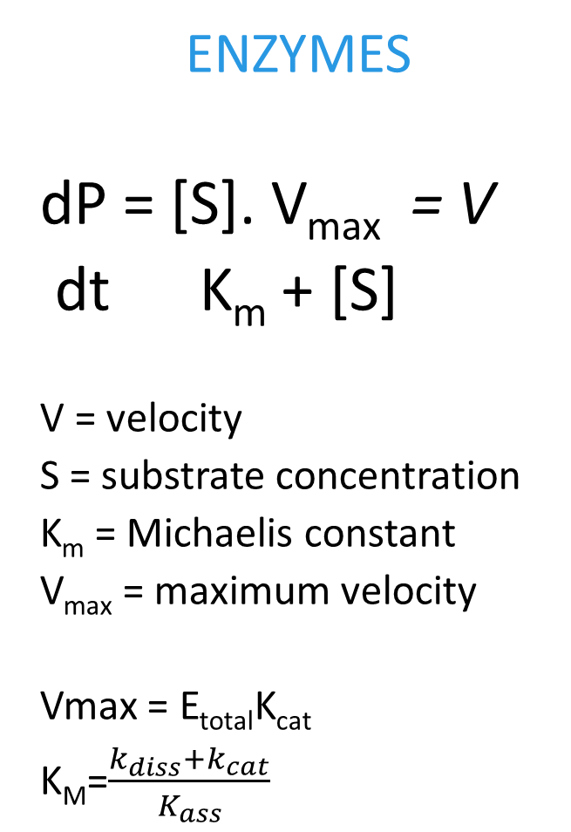
Kinetic Laws
ENZYMES
dP = [S]. V_{max} = V
dt K_{m} + [S]
V = velocity
S = substrate concentration
K_{m} = Michaelis constant
V_{max} = maximum velocity
Vmax = E_{total}K_{cat}
K_{M}=$\frac{k_{diss}+k_{cat}}{K_{ass}}$
Michaelis Menten
k_{ass} (M⁻¹s⁻¹ )
k_{cat} (M⁻¹s⁻¹ )
Binding
catalysis
E + S
ES
E + P
Unbinding
k_{diss} (s⁻¹ )

Slide 8
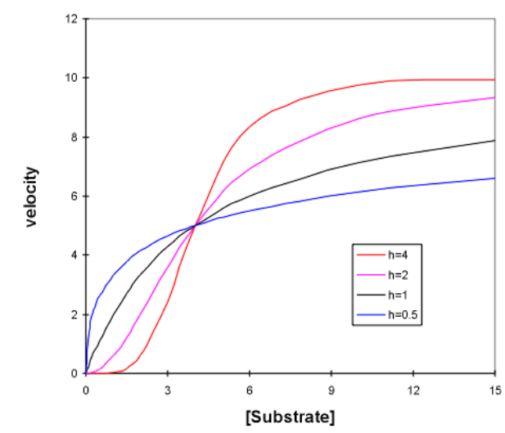
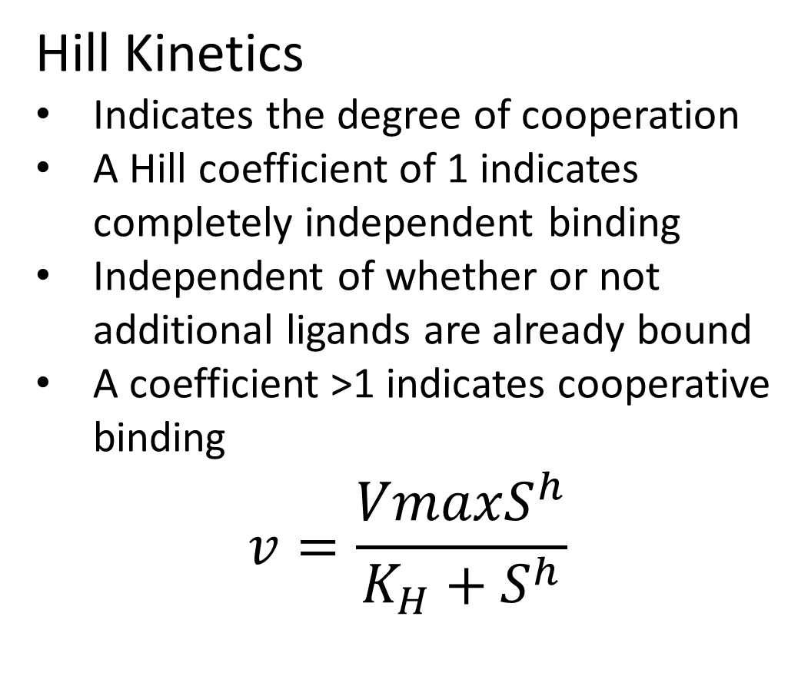
Kinetic Laws
Hill Kinetics
Indicates the degree of cooperation
A Hill coefficient of 1 indicates completely independent binding
Independent of whether or not additional ligands are already bound
A coefficient >1 indicates cooperative binding
$$v=\frac{VmaxS^{h}}{K_{H}+S^{h}}$$

Slide 9
Modelling Software
Matlab and Simbiology
-One of the most widely used numerical platforms in science and engineering
-Specialised Simbiology toolbox enables PK/PD data and kinetic data modelling
-Ordinary differential equations based modelling
-Reactions represented in the format X <-> Y
-Seamless transfer with alternative software through Systems biology mark-up language format .SMBL

Slide 10
Nuclear-Factor kappaB Pathway
NFkB Signalling
IKKa dependant activation
nNFkB nuclear transport dependant
Self-regulated negative feedback (eg. P53 mediated repression of NFkB activity)
NFkB
Involved in cellular response to stress (eg. Bacterial and viral antigens)
Failure in regulation linked to disease (eg. Autoimmune, Cancer)

Slide 11
Ashall Model
IKKn
IKKa
IKKi
A20
Ashall, L., C. A. Horton, D. E. Nelson, P. Paszek, C. V. Harper, K. Sillitoe, S. Ryan, D. G. Spiller, J. F. Unitt, D. S. Broomhead, D. B. Kell, D. A. Rand, V. See and M. R. H. White (2009). "Pulsatile Stimulation Determines Timing and Specificity of NF-kappa B-Dependent Transcription." Science 324(5924): 242-246.

Slide 12
Gong Model
PTEN
deg
PIP2
PIP3
AKT
MDM2
MDM2p
AKT-PIP3
MDM2t
PP2A
AKT-PIP
PDK
AKT-PIP2
Gong, H. J., P. Zuliani, A. Komuravelli, J. R. Faeder and E. M. Clarke (2010). "Analysis and verification of the HMGB1 signaling pathway." Bmc Bioinformatics 11.
Deg
P53

Slide 13
Hatakayama Model
R
HRG
R-HRG
R-HRG
R-HRG2
RP
deg
PI3K
R-PI3K
R-PI3K*
Hatakeyama, M., S. Kimura, T. Naka, T. Kawasaki, N. Yumoto, M. Ichikawa, J. H. Kim, K. Saito, M. Saeki, M. Shirouzu, S. Yokoyama and A. Konagaya (2003). "A computational model on the modulation of mitogen-activated protein kinase (MAPK) and Akt pathways in heregulin-induced ErbB signalling." Biochem J 373(Pt 2): 451-463.
PI3K*

Slide 14
Lipniacky Model
IKK
IKKa
Deg
IkBp
NFkBIkB
NFkB
IkB
IkBt
A20
nNFkBIkB
nNFkB
A20t
Lipniacki, T., P. Paszek, A. R. Brasier, B. Luxon and M. Kimmel (2004). "Mathematical model of NF-kappaB regulatory module." J Theor Biol 228(2): 195-215.

Slide 15
Combined Model

Slide 16
1
1 – Mass action
R
HRG
PIP2
PIP3
AKT
2 – Michaelis-Menten
1
3 – Hill Kinetics
1
1
AKT-PIP3
R-HRG
R-HRG
2
2
1
1
PP2A
AKT-PIP
PDK
PTEN
deg
2
2
R-HRG2
3
2
AKT-PIP2
1
1
1
1
RP
deg
MDM2
MDM2p
PI3K
1
IKK
IKKa
1
2
1
MDM2t
R-PI3K
Deg
IkBp
1
1
1
NFkBIkB
2
1
3
NFkB
IkB
R-PI3K*
1
1
1
IkBt
A20
PI3K*
1
1
nNFkBIkB
1
2
nNFkB
3
A20t
Deg
P53

Slide 17
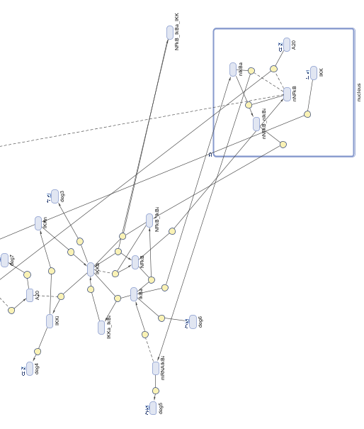
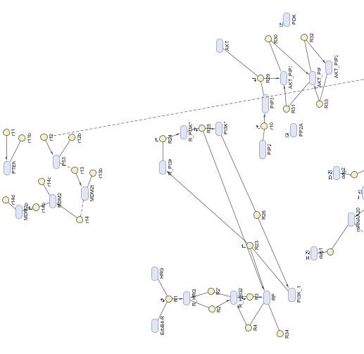
Simbiology diagram

Slide 18
Sensitivity analysis

Slide 19
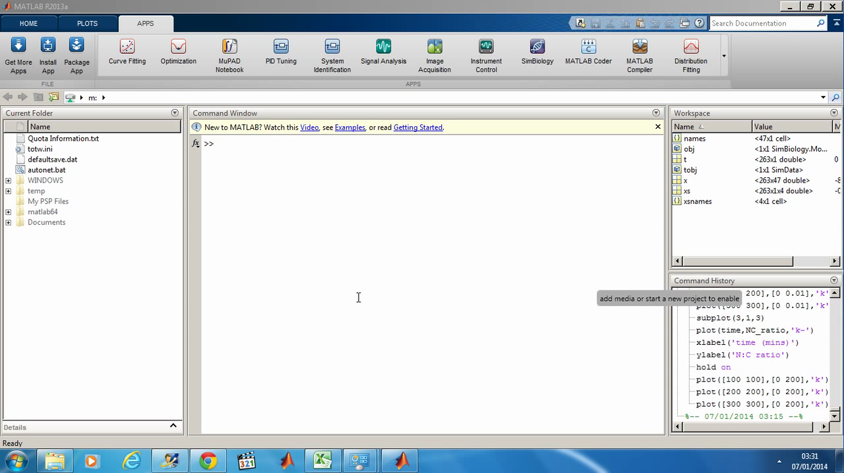

Slide 20
Sensitivity matrix

Slide 21
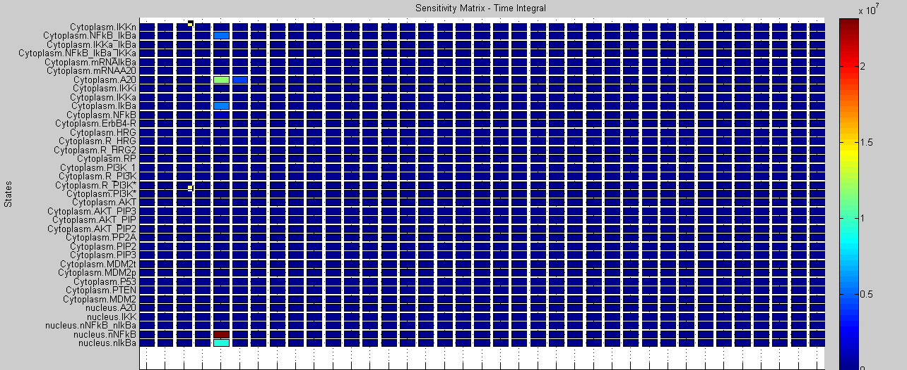
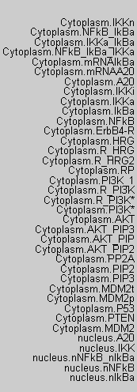

Slide 22
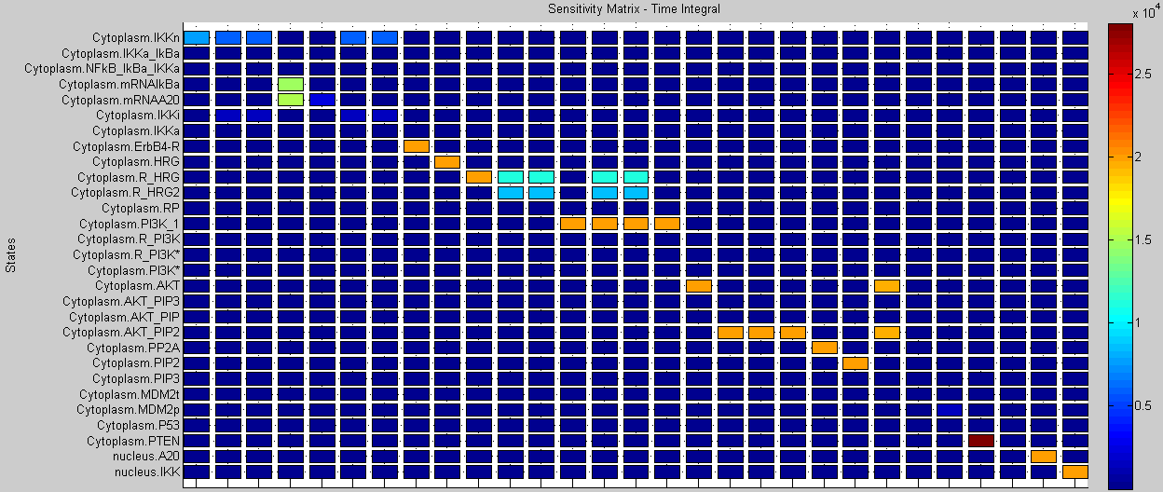
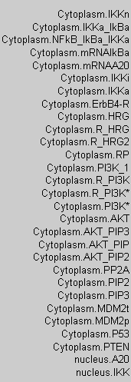

Slide 23
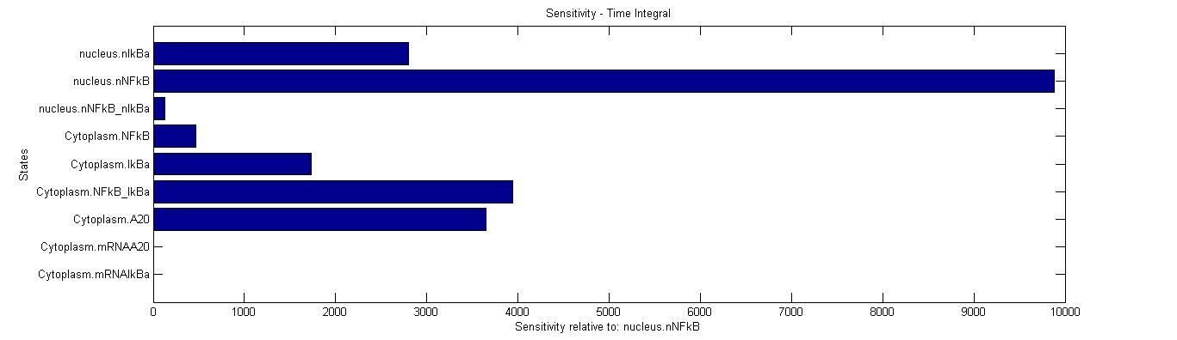
Sensitivity relative to nNFkB

Slide 24
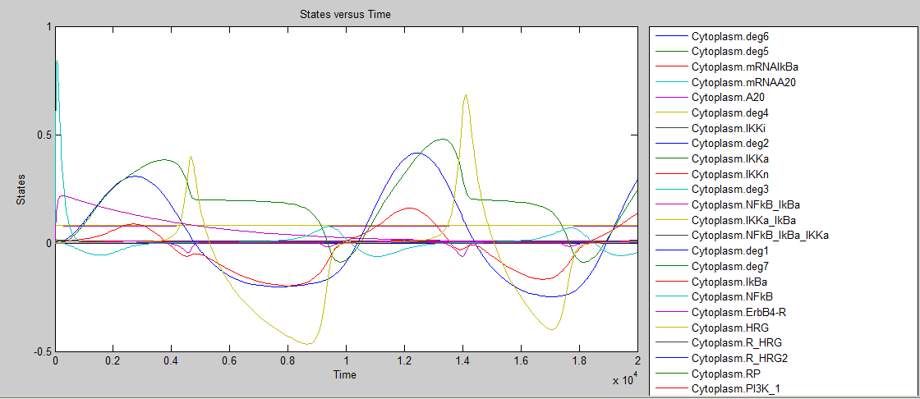
Sensitivity relative to nNFkB-Time

Slide 25
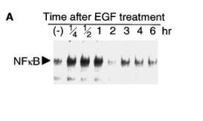

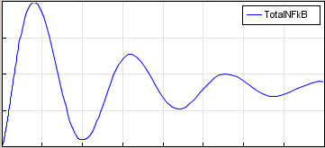

Results
Ohtsubo, M., A. Takayanagi, S. Gamou and N. Shimizu (2000). "Interruption of NF kappa B-Stat1 signaling mediates EGF-induced cell-cycle arrest." Journal of Cellular Physiology 184(1): 131-137.
1
2
3
4
5
6
7
3
*
*
2
5
*
7
*
*
*
1
6
*
4

Slide 26
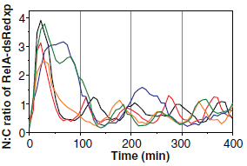
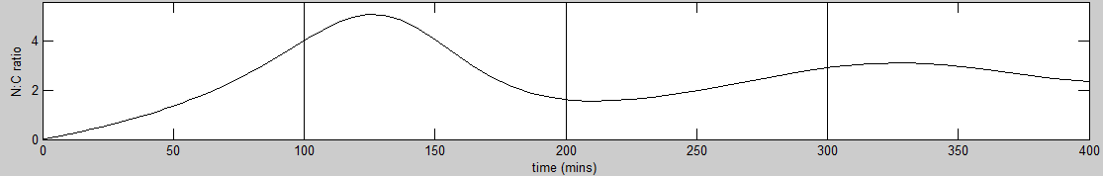
Results
Ashall, L., C. A. Horton, D. E. Nelson, P. Paszek, C. V. Harper, K. Sillitoe, S. Ryan, D. G. Spiller, J. F. Unitt, D. S. Broomhead, D. B. Kell, D. A. Rand, V. See and M. R. H. White (2009). "Pulsatile Stimulation Determines Timing and Specificity of NF-kappa B-Dependent Transcription." Science 324(5924): 242-246.

Slide 27
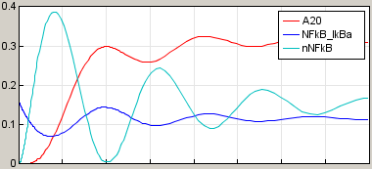
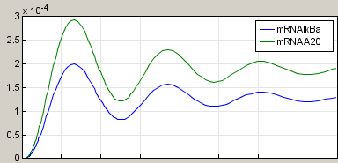

Results

Slide 28
Clinical applications
Ibrutinib- Chronic Myeloid Leukaemia
Lenercept- Septic shock
Onercept- Inflammatory conditions, psoriasis
Baminercept- Sjögren's Syndrome

Slide 29
QUESTIONS??

Slide 30
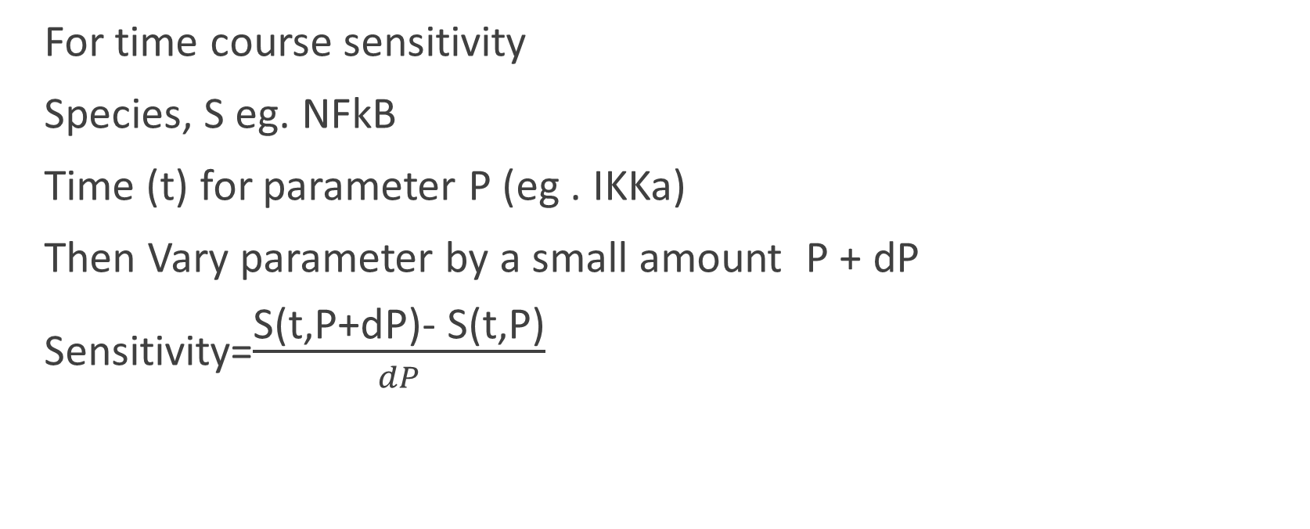
Sensitivity analysis
For time course sensitivity
Species, S eg. NFkB
Time (t) for parameter P (eg . IKKa)
Then Vary parameter by a small amount P + dP
Sensitivity=$\frac{\text{S}\text{(}\text{t}\text{,}\text{P}\text{+}\text{dP}\text{)− }\text{S}\text{(}\text{t}\text{,}\text{P}\text{)}}{dP}$

